Slide 1

MOBILE DEVELOPMENT with the ABP Framework

Slide 2

Agenda
The Latest & the Next ABP Releases
ABP Community News
ABP Mobile Development

Slide 3
The Latest & the Next ABP Releases

Slide 4
ABP v7.3 Final
7.3.0 was released at July 12, 2023. 7.3.1 has been released today!
Blog Post (shortened) URL: https://abp.io/b/v73
Volo.Abp.Imaging.* Packages to manipulate (resize & compress) images
Nonce attribute support for Content Security Policy (CSP)
Monitoring distributed events in-process
Ordering execution of local event handlers
Many enhancements & bug fixes (700+ commits)

Slide 5
ABP v7.4 RC
Planned Release Date: August 15, 2023
ABP Framework
Dynamic setting store
Adding CorrelationId to distributed events
Do not expose integration services / controllers by default
ABP Commercial
Mobile Application
Renewing the mobile applications
ABP Suite
Keep customized code on re-generation for CRUD page generation
Master/Detail entity support for CRUD code generation*
Modules:
Account/Identity: Password complexity indicator
Chat: Delete messages/converstations
Text Template Management: Support distributed systems for text template customizations

Slide 6
Mobile Application Improvements coming with the ABP v7.4
Revised the application functionalities, like profile management, user and tenant management, authorization code flow for login
Renewing the UI design
Preparing a development tutorial
After v7.4: New mobile framework integrations? Write your comments!

Slide 7
ABP v8.0 RC
Planned Release Date: November 15, 2023.
Based on .NET 8.0

Slide 8
ABP Community News

Slide 9
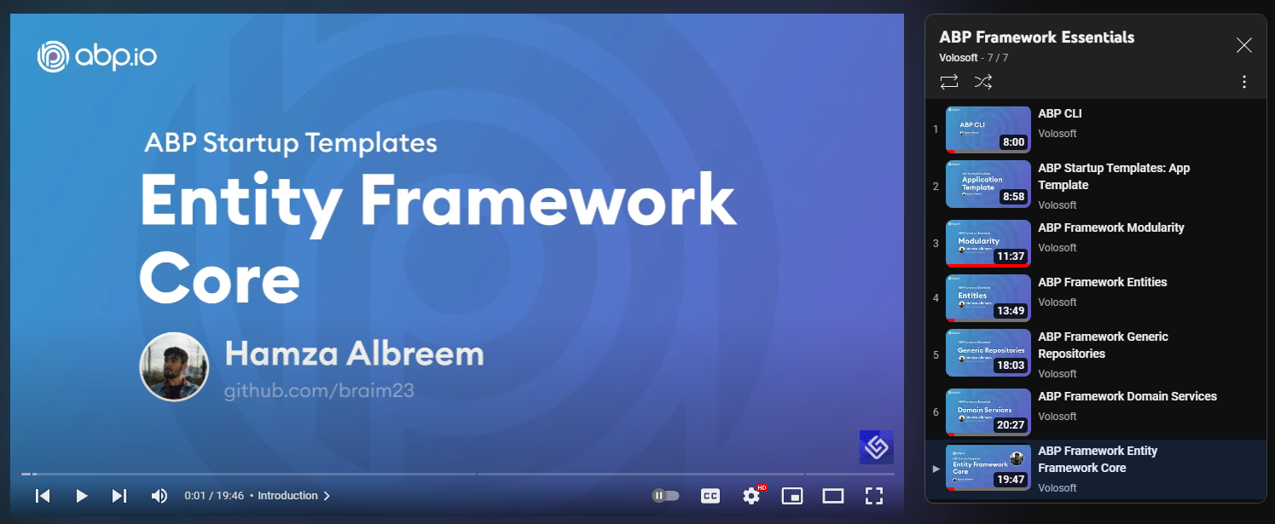
Video Series: ABP Framework Essentials 7 videos / 100 minutes of content
https://www.youtube.com/@Volosoft

Slide 10
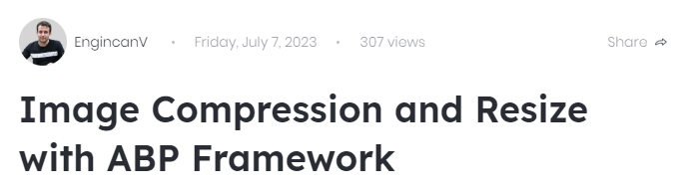



Latest Posts https://community.abp.io

Slide 11
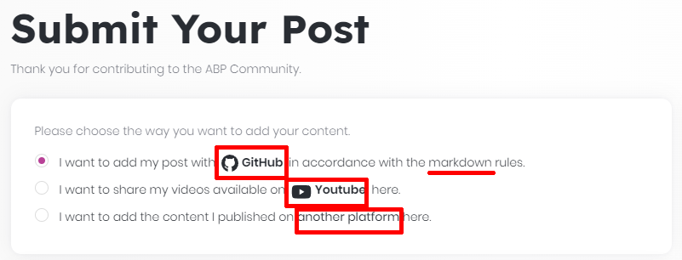
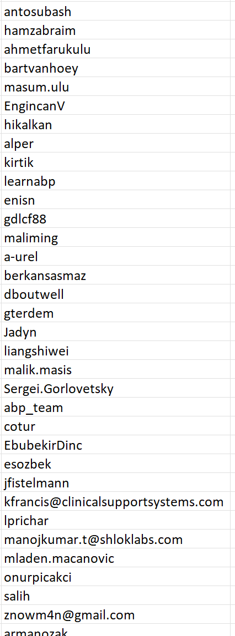
ABP Community Stats
165 Text Articles
98 Video Posts
By 51 Authors
https://community.abp.io/posts/submit
Top Authors:

Slide 12
ABP Mobile Development

Slide 13
ABP Client Application Development
Authenticate the User
Use Integration Endpoints to initialize the UI
Use REST / gRPC / WebSockets... to consume server-side resources

Slide 14
Authentication
Cookie/header based authentication
Microsoft Identity based cookie authentication
OpenIddict integration: OAuth 2.0 & OpenID Connect
Authorization Code / Implicit / Hybrid Flows
Client Credentials / Resource Owner Password Grant
Decide Authorization Flow
Use OpenID Connect or other flows to connect to 3rd-party authentication servers, like Azure or Keycloak.

Slide 15
ABP Client Integration Endpoints
/api/abp/application-configuration
/api/abp/application-localization
Available Languages / Cultures
Current User Info
Features
Multi-Tenancy / Current Tenant
Permissions
Settings
User’s Timezone
All localization texts

Slide 16




Pre-Built Mobile Options
ABP works with any kind of client applications, including all web or mobile frameworks. However, there are some pre-integrated solutions.
Open souce & free

Slide 17
Pre-Built Functionalities
Integrated to backend
Login / Logout (authorization code flow)
A simple Welcome (home) screen
Administration
User management (CRUD)
Tenant management (CRUD)
Settings
Change password
Change profile picture (camera, gallery, etc)
Change UI Theme (light / dark)
Switch language
Full source code included in with startup template. No closed library!

